Slide 1
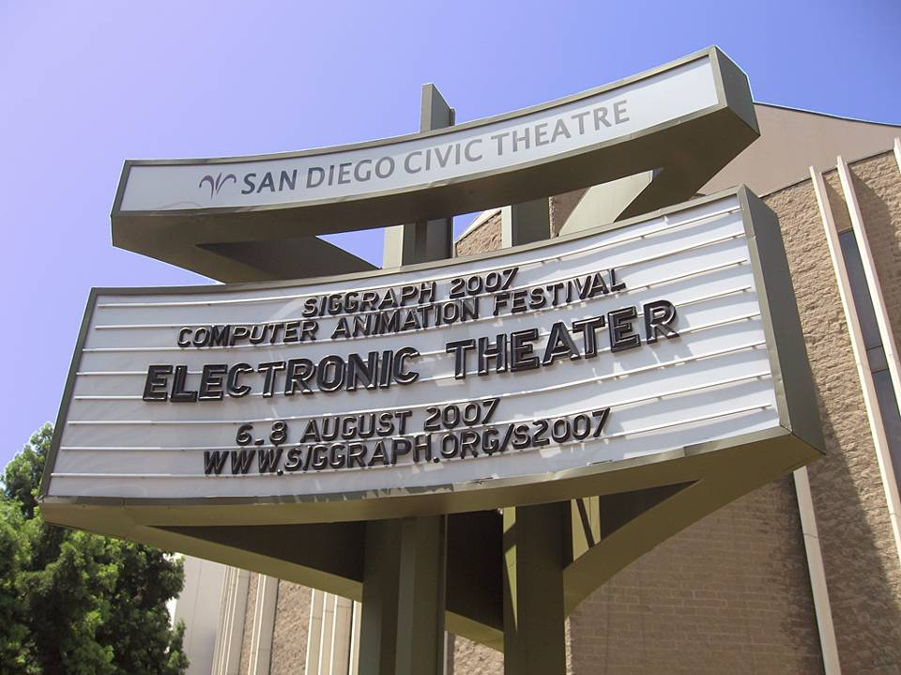
SIGGRAPH 2007 Electronic Theater
Special Screening

Slide 2
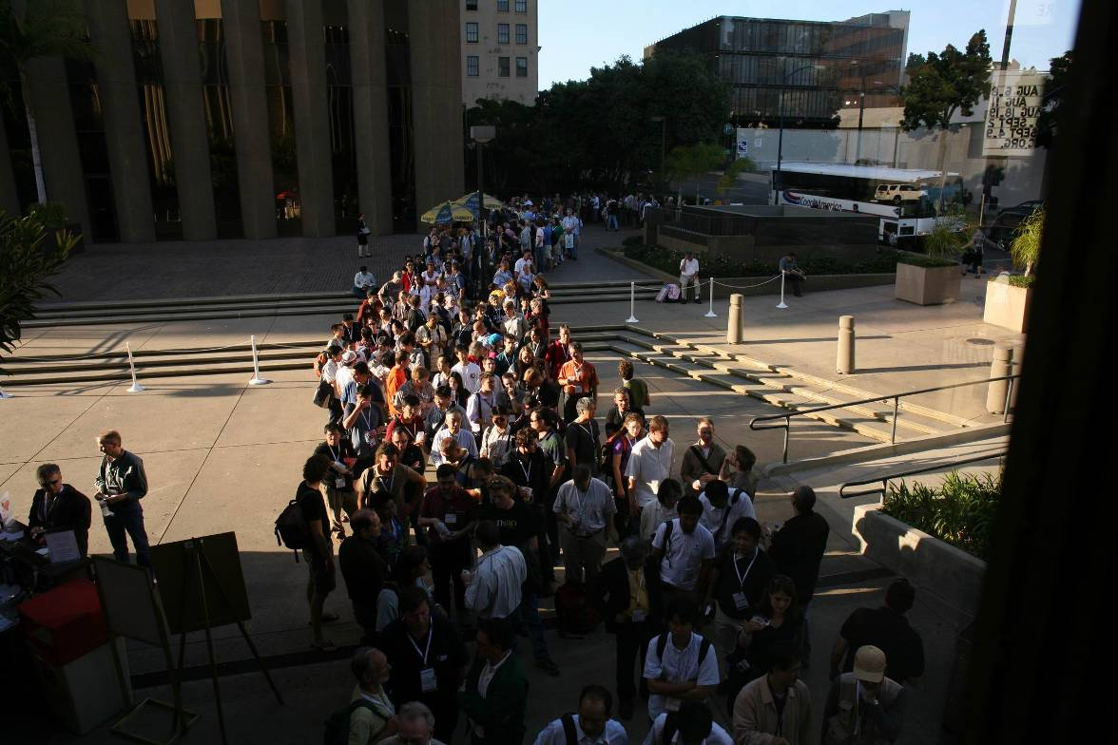
The line for the Wednesday evening show forms outside the Civic Theatre

Slide 3
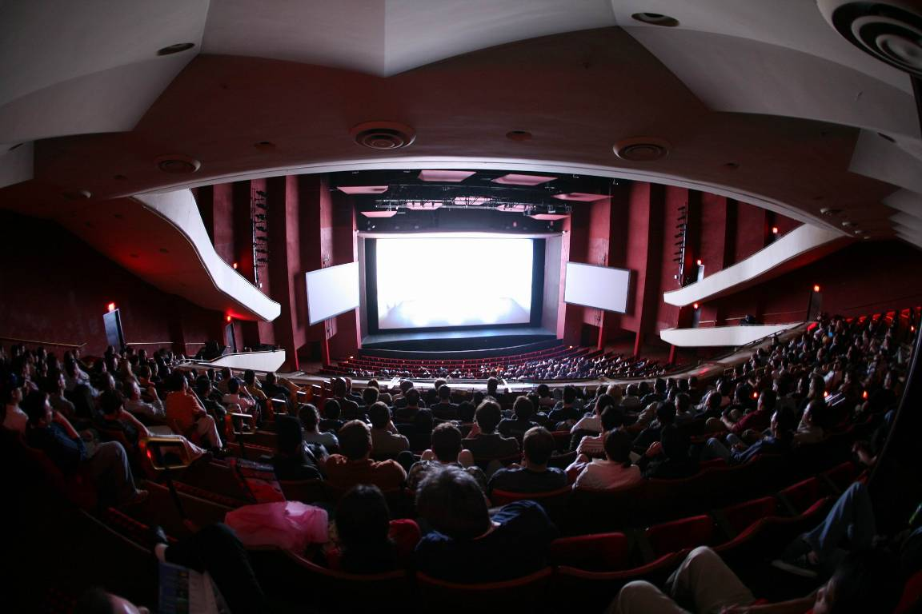
Fisheye view of the preshow in progress from the balcony

Slide 4
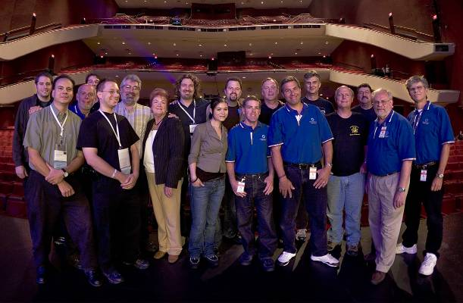
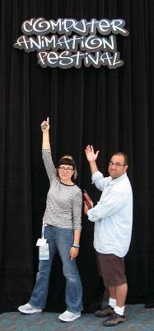
Computer Animation Festival Committee
Paul Debevec, Chair
Maya Martinez
Electronic Theater &
Outreach and Event Producer
Carlye Archibeque
Assistant Producer
Sebastian Sylwan
Technology Director
Tom Pereira
Animation Theater Producer
Samuel Lord Black
Minister of Information

Slide 5
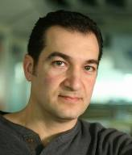
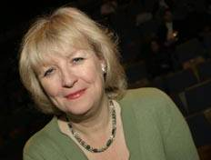
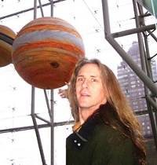
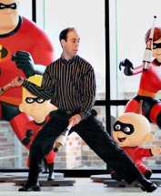
Habib Zargarpour
Electronic Arts
Shelley Page
Dreamworks
Jay Redd
Sony Imageworks
Computer Animation
Festival Jury
Nickson Fong
Egg Story
Randal Kleiser
RK Productions
Carter Emmart
Hayden Planetarium
Gavin Miller
Adobe
Michael Kass
Pixar

Slide 6
Goals for the 2007 CAF
Selection Criteria:
  Innovation – shows us something we’ve never seen before
  Excellence – all production aspects executed well
  Representation – selections represent the scope of innovative and excellent material across all categories
Jurors chosen to be experts at recognizing innovation & excellence in at least two categories
Strong outreach especially to underrepresented categories

Slide 7
Record submissions!
905 valid submissions
Many pieces submitted at 720p resolution
55 hours of material (!)
Good representation across categories:
489 Animation
108 Art
118 Broadcast
16 Cinematic
48 Real Time
33 Research
56 Visual Effects
37 Visualization

Slide 8
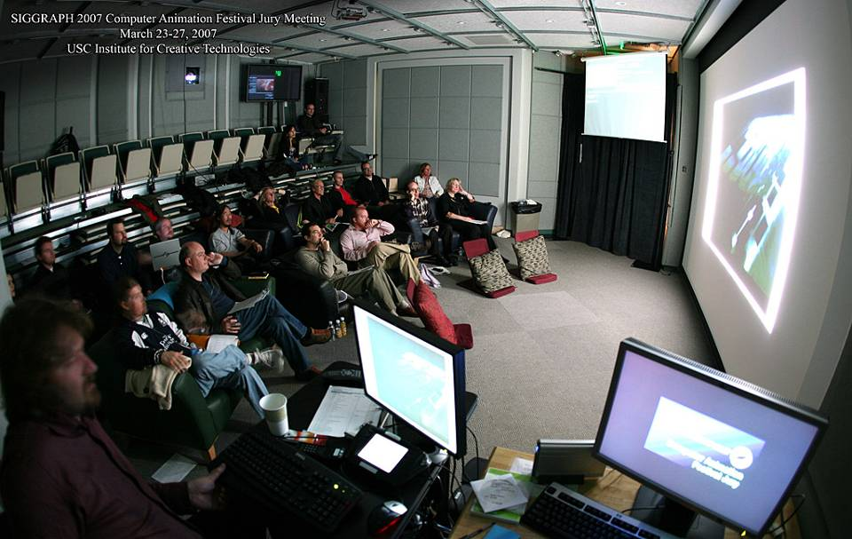
Jurying in the main screening room at USC ICT

Slide 9
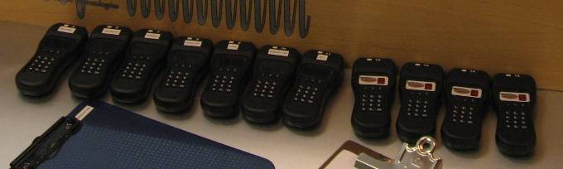
Jury Meeting
Electronic Submission System from 2006 expanded to allow for 1280x720 HD resolution
Voting wands allowed faster, more precise jurying and allow juror’s votes to be more independent, with no worries about how their vote will look to others
Careful management of conflicts of interest

Slide 10
Final Selections
Electronic Theater (36) Animation Theaters (93)
12 Animation
1 Art
7 Broadcast
0 Cinematic
5 Real Time
2 Research
9 Visual Effects
1 Visualization
32 Animation
4 Art
15 Broadcast
5 Cinematic
8 Real Time
5 Research
9 Visual Effects
8 Visualization

Slide 11
































Final Selections
35 Electronic Theater (93 Animation Theaters )
12 Animation
1 Art
6 Broadcast
3 Cinematic &
Real Time
3 Research
8 Visual Effects
1 Visualization

Slide 12
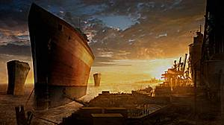
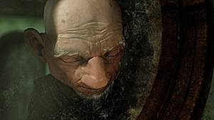
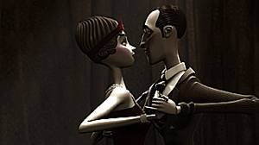
And the award winners are:
Ark – Best of Show
  Grzegorz Jonkajtys & Marcin Kobylecki
  Independent Filmmakers, Poland
Dreammaker – Jury Honors
  Leszek Plichta
  Institute of Animation, Visual Effects and Digital Post Production / Filmakademie Baden-Wurttemberg, Germany
En Tus Brazos – Award of Excellence
  Francois-Xavier Goby, Edouard Jouret, Matthieu Landour
  Supinfocom Valenciennes, France

Slide 13
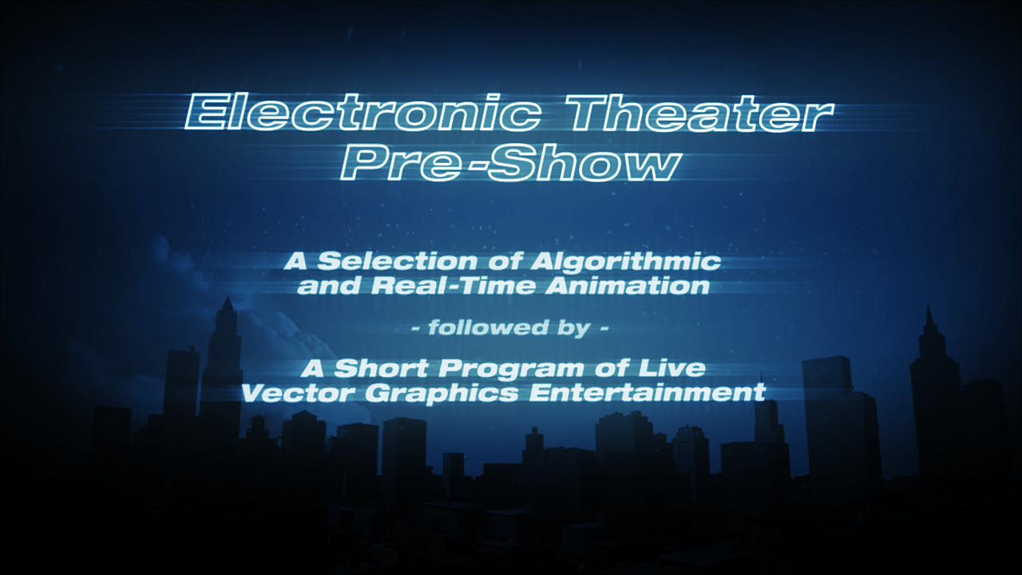

Slide 14
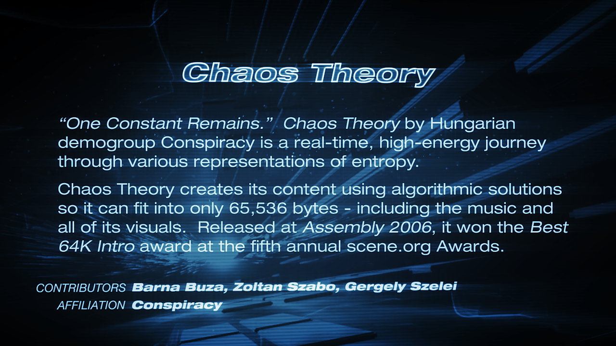
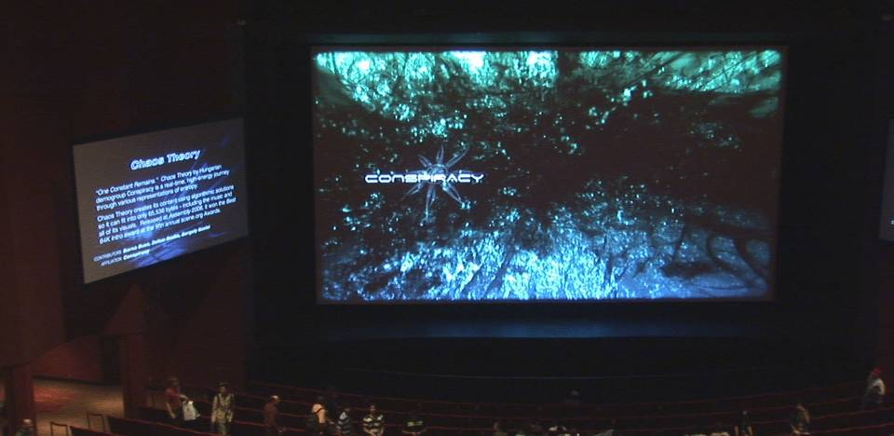

Slide 15
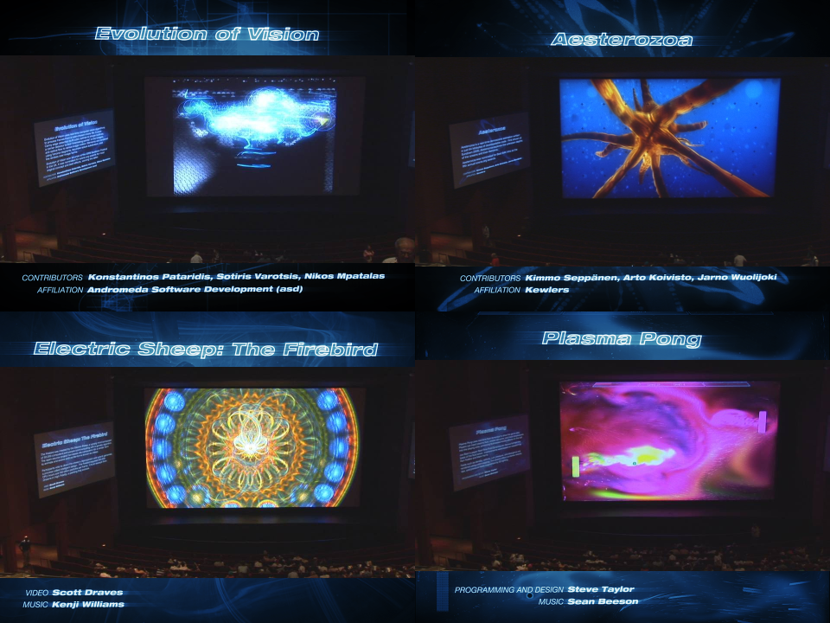

Slide 16
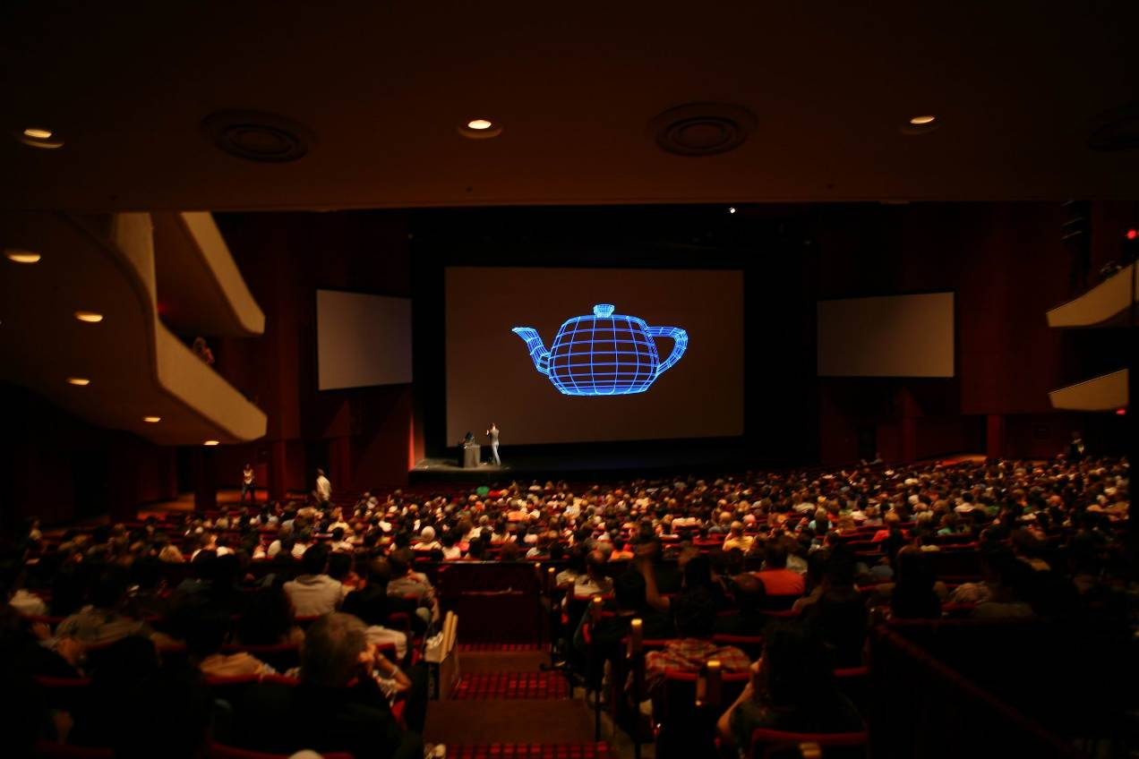

Slide 17
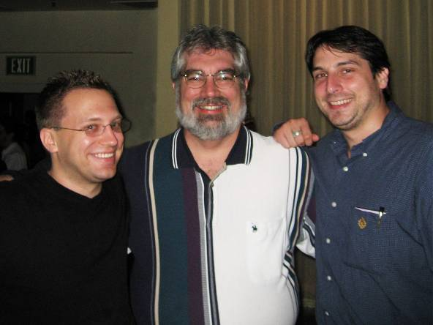
The Laser Guys!
Matt Polak
Raven Systems Design
Cleveland, OH
Steve Heminover & Mike McHale
Aura Technologies
Chicago, IL

Slide 18
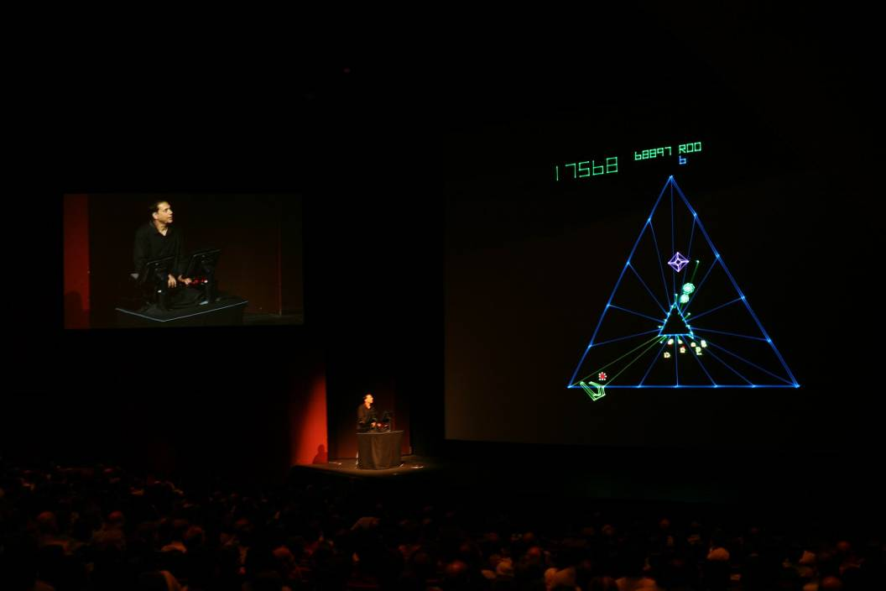
Ken Perlin plays Tempest

Slide 19
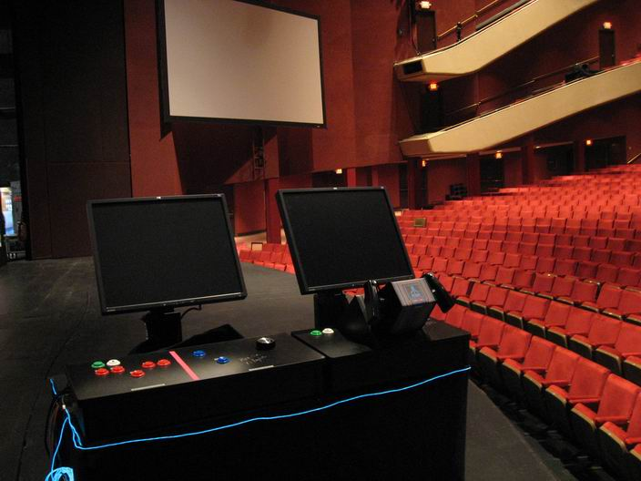
Custom authentic arcade controllers from WESTCONTROLS

Slide 20
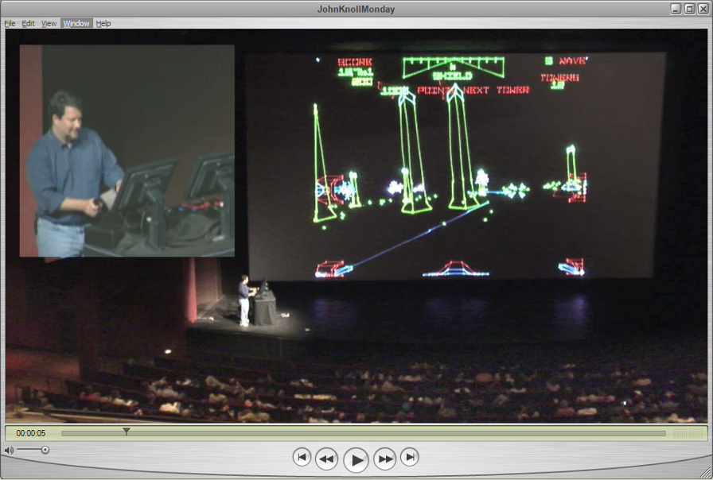
Video: John Knoll plays Star Wars on opening night, blows up death star!

Slide 21
Extra Special Thanks
RIOT – Chris Almerico, Colby Allen, Matthew McManus (HDCAM/SR)
Andy Lesniak (Opening Sequence), Chris Blyth (AT Trailer),
Florian Witzel (Title Animations)
Jim Blinn, Michael Cohen, David Theil (Papers Preview)
Atari – Kathyrn Butters and LucasArts/ILM - Miles Perkins
Hewlett-Packard (Jury System Computers)
SONY Pictures Imageworks - Brian Hamblin, Sean Callan, Dawn Guinta, Sande Scoredos, Don Levy (HDCAM and DVD)
Technicolor – Bob Michaels, Miles DelHoyo, Nathan Phillips (Blu-Ray Disc)
Rob Groome, Drew Weiss, Tom Pereira, Randy Hill, Bill Swartout

Slide 22

SIGGRAPH 2008
www.siggraph.org/s2008/
Los Angeles, August 11-15
Computer Animation Festival Submit: 30 January 2008
Upload: 27 February 2008
Student Volunteers Applications Submit: 24 February 2008

